Slide 1

Getting Started With ANSI/ISA-95
ISO/IEC 62246
Bob Mick
VP Emerging Technology
ARC Advisory Group
bmick@ARCweb.com
November-2003

Slide 2
Outline
Introduction to ISA-95
Comparing ISA-95 with other standards
Supplier alignment
End user strategies
ARC ISA-95 portal and forums

Slide 3
What is ISA-95?
Short for:
ANSI/ISA-95 and
ISO/IEC-62246

Slide 4
ISA-95 Scope
Consistent Terminology
  Foundation for supplier and end user communications
Consistent Information Models
  Foundation for consistency between suppliers
Consistent Operations Models
  Foundation for clarifying product functionality – how information is to be used
Consistent Message Contents
A Foundation for
Production to Business Integration

Slide 5
ISA-95
“Enterprise to control system integration”
Includes batch, continuous and discrete
The interface between:
  Business planning & logistics (“level 4”)
  Manufacturing operations & control (“level 3”)
Part 1 describes model: terms, definitions, functions, object structure, and messages
Part 2 describes: object attributes
Part 3 describes a model of operational activities – still under development
Part 4 details operations
Part 5 defines messaging requirements
ISO/IEC is processing the ANSI/ISA-95 Specifications

Slide 6
How Does ISA-95 Relate to Other Standards?

Slide 7
Complementary Scopes – Some Overlap
Business
Support
E-Commerce
Business, Materials
CIDX, OAGi, ebXML, etc.
Suppliers
Customers
Production
OAGi
Production
ISA-95
Design
Production
Notes:
Manufacturing involves many competing objectives and dynamic business demands. ARC’s Collaborative Manufacturing Management Model provides a map for understanding the relationships among the application domains and their positioning. It is a three dimensional model covering:
Enterprise Axis from the plant floor to business systems.
Supply Chain Axis covering source, make and deliver.
Lifecycle Axis including design through to support of the installed base.
BPM is a new, growing area for automation a company’s internal business processes. For example, think of the questions that must be answered prior to accepting an order. Is their credit rating acceptable? Can it be made (configuration or recipe)? Can it be delivered when requested? Is the price correct? Substantial savings are available if these questions can be answered in an automated fashion through Business Process Management.
Application domain areas can be mapped on this model. This map is used to model the flow of data and information among applications as they are integrated.
In the ARC October 2001 Strategy Report on Collaborative Manufacturing Management, Greg Gorbach states, “The essence of collaboration is the ability for individual plants to synchronize their work in real-time based on customer orders and to coordinate the production and delivery of component materials at the production level in a highly distributed manner.”

Slide 8
ISA-95 Does Not Define Implementation
General Standards
Terminology and Models
Discovery and Management
Operations Models
ISA-95
Architecture
Processes
Documents
Technical
ebXML, etc.
Interfaces
Messages
Delivery
Physical Transport

Slide 9
ISA-95 and (a Few) Other Standards
Spec | Description | Comments
ISA | Has many other standards | ISA-88 is closely related to ISA-95
W3C | XML Standards | XML, XML, Schema, XSLT, XPATH, etc.
OMG | UML Standard (among others) | UML used within ISA-95
OPC | Provides access to plant floor data | Broad industry support
OAG | E-business & plant floor integration | Automotive mostly, extensible methods for specifics
OASIS | Broad range of standard | Provides implementations
CIDX | E-Business, some ISA-95 over lap for inventory | Chemical Industry

Slide 10
ISA-95 Does Not Define Implementation
No structures, message formats, documents, API’s, Interfaces, technologies, etc.
The SP95 committee could define some of these in the future
ISA-95 Defines
  Terminology
  Functional Requirements, …
The World Batch Forum has implemented parts of ISA-95 in XML Schemas, and made them freely available
Suppliers can “align” with ISA-95 and define their own implementations

Slide 11
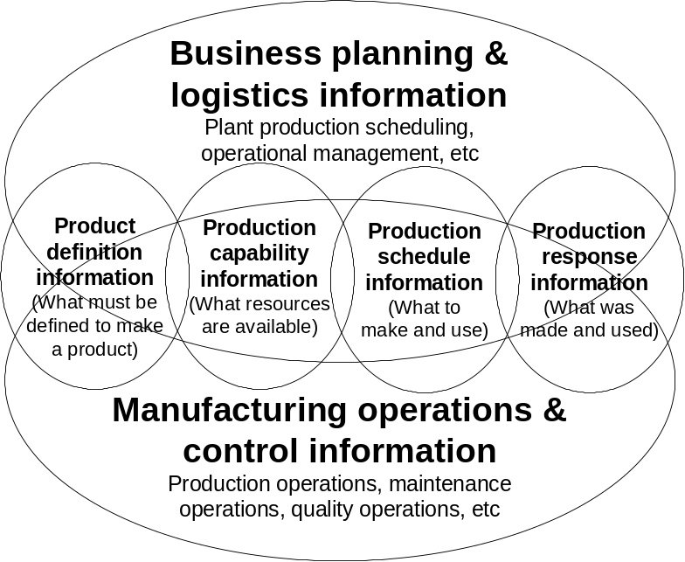
ISA-95 Architecture
Models and Terminology for Integration
ISA-95 Models:
Context
Hierarchy Models
  Scheduling and control (Purdue)
  Equipment hierarchy
Functional Data Flow Model
  Manufacturing Functions
  Data Flows
Object Models
  Objects
  Object Relationships
  Object Attributes
Operations Activity Models
  Operations Elements: PO, MO, QO, IO
  Operations Data Flow Model
    Operations Functions
    Operations Flows
Information Exchange Context
Reference: ISA-S95 Draft 11

Slide 12
Supplier Alignment Possibilities
Section | Defines | Uses
Part 1 Sect 5.1 | Functional “hierarchy” and domain overviews | Setting general context (not an alignment)
Part 1 Sect 5.2 | Equipment hierarchy | Defines number of levels and names
Part 1 Sect 6.1 | Manufacturing functions | Standardize partitioning of product functions
Part 1 Sect 6.2 | Information flows | List of information flows & text descriptions
Part 1 Sect 7 | Object models: defines classes & relationships | Information structure
Part 2 | Object attributes | Object details
Part 3 Sect 4.1 | Manufacturing Operations | Function Processing
Part 3 Sect 4.9 | Manufacturing Activities | For each operation
See ARC-ISA-95-Basics.ppt for details

Slide 13
Supplier Alignment
Supplier Strategies
  Align with functional partitioning (modules, mapping)
  Align with data models (various depths)
  Align with data flows (high level)
Suppliers can also:
  Provide explicit integration know-how (documents relating ISA-95 to existing supplier product)
  Adopt the WBF XML Schemas for exchanging information.
  Provide ISA-95 Solution
    XML or other message structures
    Transformation capability (maps to tools)
    ISA-95 integration environment
    Complete integrations with popular applications

Slide 14
Suppliers - Public Indication of Support
See the ARC ISA-95 Information Portal
“ISA-95 Supplier List”

Slide 15
Why Should Suppliers Be Concerned?
Drivers
  Support end user reference models (for cutting costs)
  Reduce effort in responding to RFPs
  Competition: Some suppliers will touting ISA-95 alignment
  Opportunity for influencing the enterprise integration platform

Slide 16
End User Strategies

Slide 17
End User Alignment
End User Strategies
  Use functional partitioning when sourcing software – an ISA-95 Reference Model
  Use data models for sharing information across apps
  Define a consistent set of data flows for integration
  Define an enterprise wide integration platform
End Users can also:
  Modify existing infrastructure to adopt the WBF XML Schemas (or other) for exchanging information
  Define an enterprise wide platform leveraging ISA-95
    XML or other message structures
    Transformation capability (maps to tools)
    Integrations with selected applications
  Adopt a specific suppliers ISA-95-aware integration platform

Slide 18
End Users - Indication of Interest
End users are interested in ISA-95 and are using it in a variety of ways:
  Reference model for engineering activities, planning, request for proposals, evaluations, …
    Reducing cost and time
    Consistency for collecting ROI information
  Standardizing integration documents and messages
  Standardizing object and data models
User interest is mainly from Chemicals, Food, and Pharma – no real discrete industry interest
Expressing some interest: See the ARC ISA-95 Information Portal – User List and Cases List

Slide 19
Summary

Slide 20
Looking Forward
Parts 1-3 are a good start
International acceptance (IEC 62246) is underway
Interoperability is needed
WBF schemas are a good start – need a better home and management processes?
ISA should look at other (mature) standards to define implementation profiles
ISA-95 impact on user practices is just starting
A broader community will participate in the further evolution and utilization of ISA-95. Effective and open collaboration will be critical.

Slide 21
ARC Forums Activities
For several years ARC has been organizing forums covering emerging manufacturing topics
In June 2003, ISA-95 roundtable discussions lead to the creation of an ISA-95 portal to encourage collaboration and information sharing
Future forums will include appropriate ISA-95 related discussions, panels, presentations, and meetings
In July 2004, ARC moderated an interoperability workshop sponsored by SAP. Anongoing working group was created
See the ARC ISA-95 Information Portal for announcements of future events and meetings

Slide 22
ARC Action: Managing an ISA-95 Portal
Supplier
Directory
Resources & Links
Supplier
Interviews
Standards
Presentations
Papers
User Adoption
News & Events
Web
Surveys
ISA-SP95
Demonstrations
Forums
Make ISA-95 Value Visible and Accessible

Slide 23
End
Send comments and suggestions to bmick@arcweb.com

